Slide 1
Navigating Sales Insights: Illuminating Future Trends and Performance

Slide 2
Team Members
G. Vaishnavi:- 2110030009
G. Haritha Maithreyee:- 2110030014
D. Neha:- 2110030032

Slide 3
Problem Statement
Sales forecasting is a critical challenge in the ever-evolving business landscape. Accurate
prediction of future sales enables companies to optimize inventory, allocate resources
efficiently, and make informed strategic decisions. The complexity of today's markets, the
influence of external factors, and the vast amount of data available make this task
increasingly intricate.
Problem statement revolves around developing a robust and data-driven sales forecasting
model that accounts for various variables, including historical sales data, market trends,
seasonal patterns, and external factors like economic conditions and marketing campaigns.
The goal is to create a predictive framework that not only provides accurate short-term and
long-term sales forecasts but also adapts to changing market dynamics.

Slide 4
Introduction
Sales forecasting is a pivotal business practice involving predicting future sales to optimize resource allocation, inventory management, and marketing strategies.
These methods include qualitative, quantitative, causal, and machine-learning approaches.
By harnessing historical data and predictive models, businesses can anticipate market trends, enhance decision-making, and adapt proactively to changing conditions for sustained growth.

Slide 5
Objectives
Time series models like ARMA, ARIMA, and SARIMA analyze historical sales data to predict future sales trends accurately.
By identifying patterns and trends, these time series models assist businesses in understanding market dynamics and planning effectively.
Accurate sales forecasts generated by these models enable organizations to make informed decisions regarding inventory management, resource allocation, and marketing strategies.
The insights provided by time series models like ARMA, ARIMA, and SARIMA support proactive planning for product launches, promotions, and overall business strategy, leading to improved performance and competitiveness in the market.

Slide 6
Literature Review
Study | Method Used | Key Findings
Smith et al. | ARIMA - Autoregressive Integrated Moving Average (Time Series) | Accurate short-term forecasts using ARIMA. Seasonal patterns have a big impact.
Zhang et al | LSTM - Long short-term memory (Deep Learning) | LSTM is great for capturing sales sequences and long-term trends.
Brown et al. | Causal Modelling | Using economic indicators improves long-term predictions. Consider demand elasticity.
Lee and Kim | Hybrid (ARIMA & ML) | Combining ARIMA and ML boosts accuracy. ML for patterns, ARIMA for seasonality
Chen et al. | Random Forest (ML) | Random Forest works well, especially with holidays and promotions.

Slide 7
Theory
ARIMA, ARMA, and SARIMA models are powerful statistical tools for sales forecasting.
They analyze historical sales data to generate accurate predictions for future sales trends.
ARMA models assess autoregressive and moving average components, providing deeper insights into underlying sales patterns and fluctuations.
ARIMA methodologies help optimize inventory levels, streamline supply chain management, and allocate resources efficiently based on anticipated demand.
SARIMA models incorporate seasonal variations, making them useful for industries with predictable seasonal trends like retail, agriculture, and tourism.

Slide 8
SARIMA models incorporate seasonal variations, making them useful for industries with predictable seasonal trends like retail, agriculture, and tourism.
SARIMA models capture seasonal patterns, enhancing insights into demand fluctuations across different time periods for better resource planning.
ARIMA, ARMA, and SARIMA models identify trends and patterns in sales data, supporting risk management efforts.
They highlight potential fluctuations in demand and revenue, enabling businesses to adjust strategies proactively.

Slide 9
Hardware Requirements
Processor : i3 or above
Ram : 2 GB or above.
Processor speed : 2.40 GHz

Slide 10
Software Requirements
Language : Python
Version : Python 3.9.4
Operating System : Windows
Tools used : Jupyter notebook

Slide 11
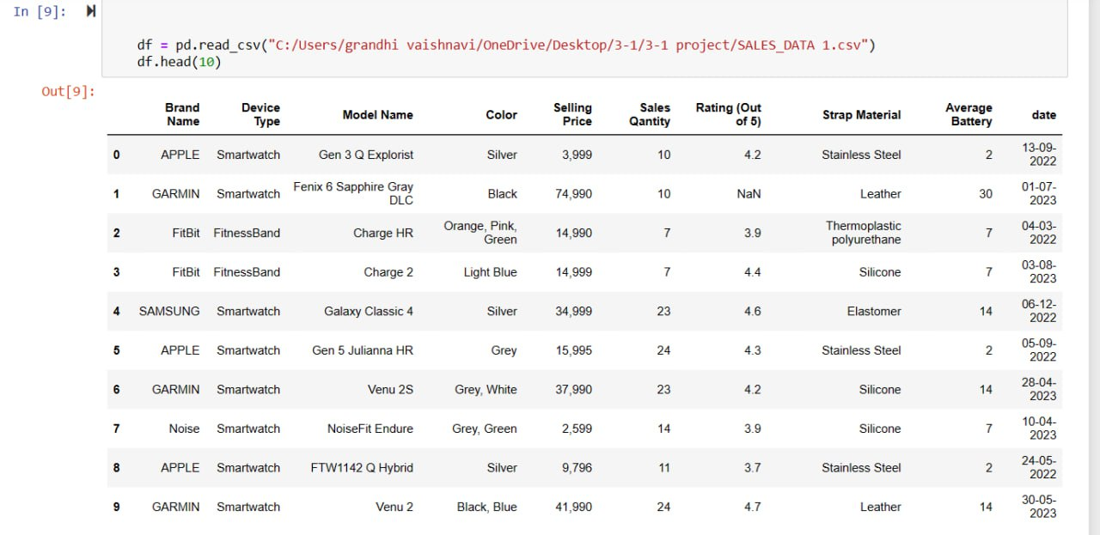
Dataset

Slide 12
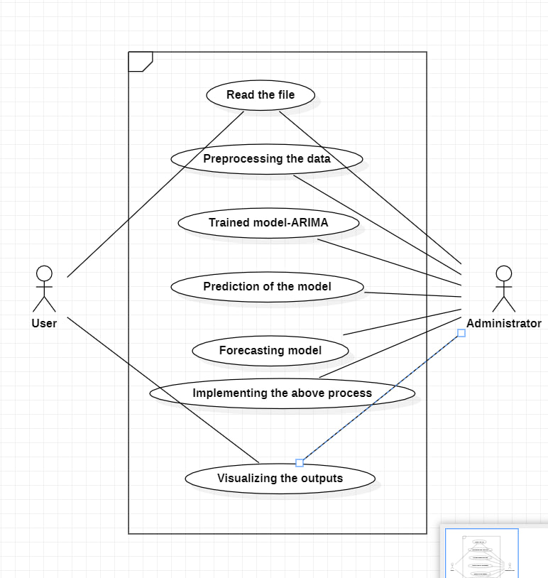
Use Case Diagram

Slide 13
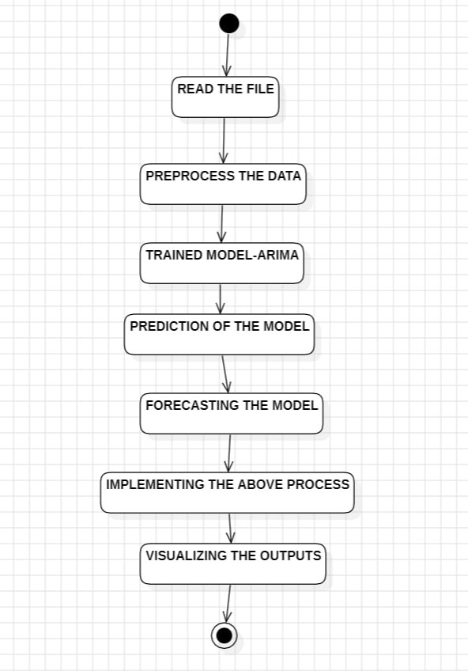
Activity Diagram

Slide 14
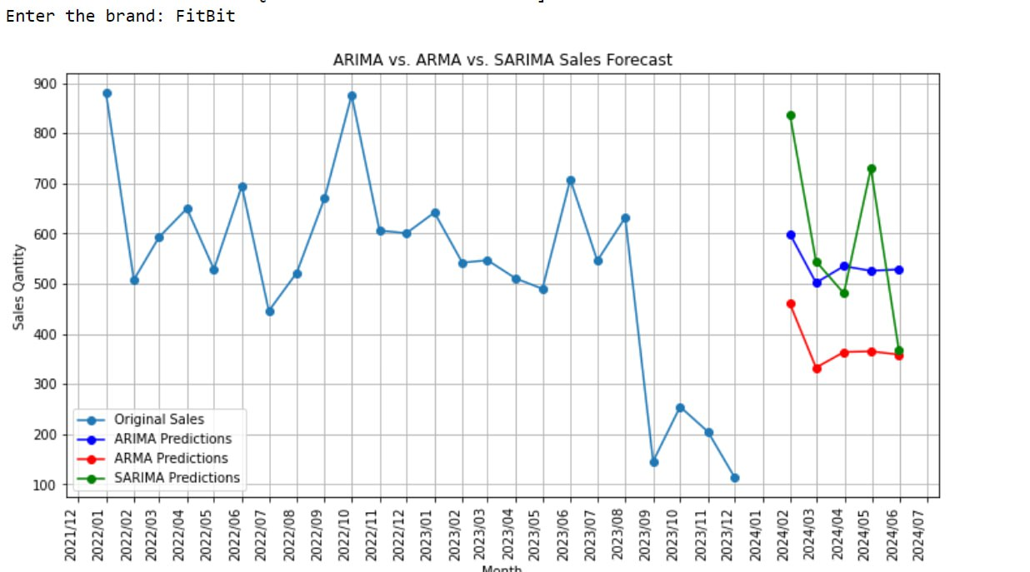
Outputs

Slide 15
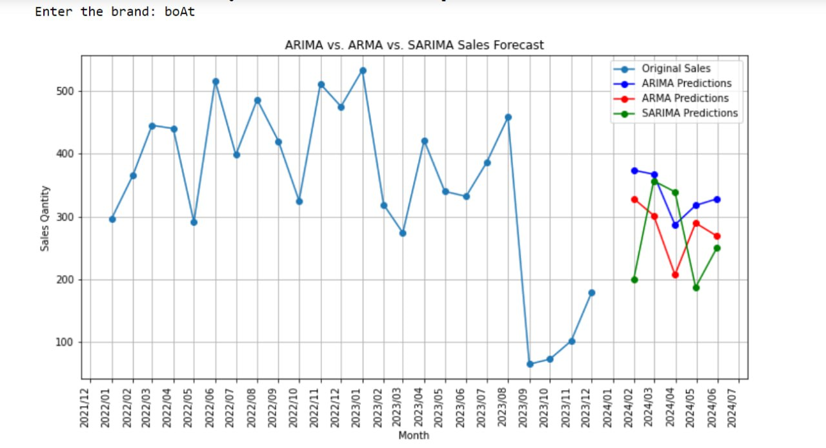

Slide 16
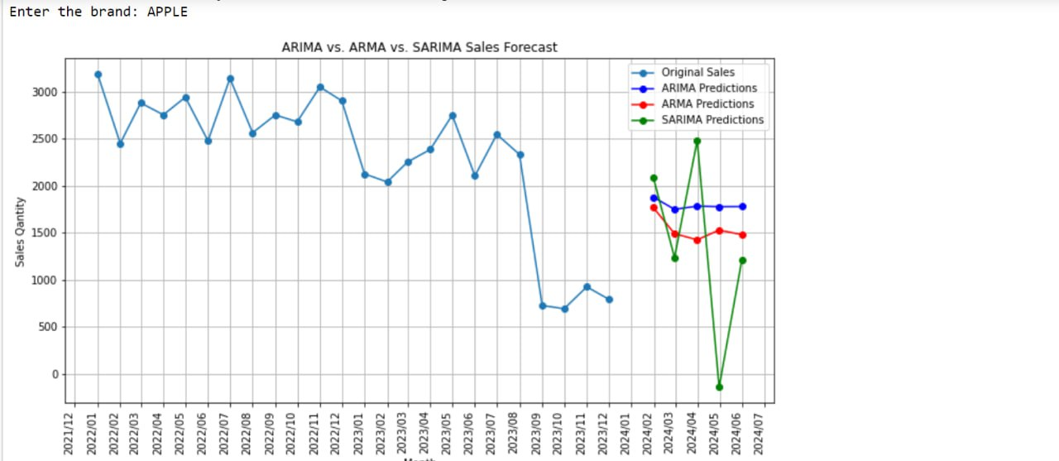

Slide 17
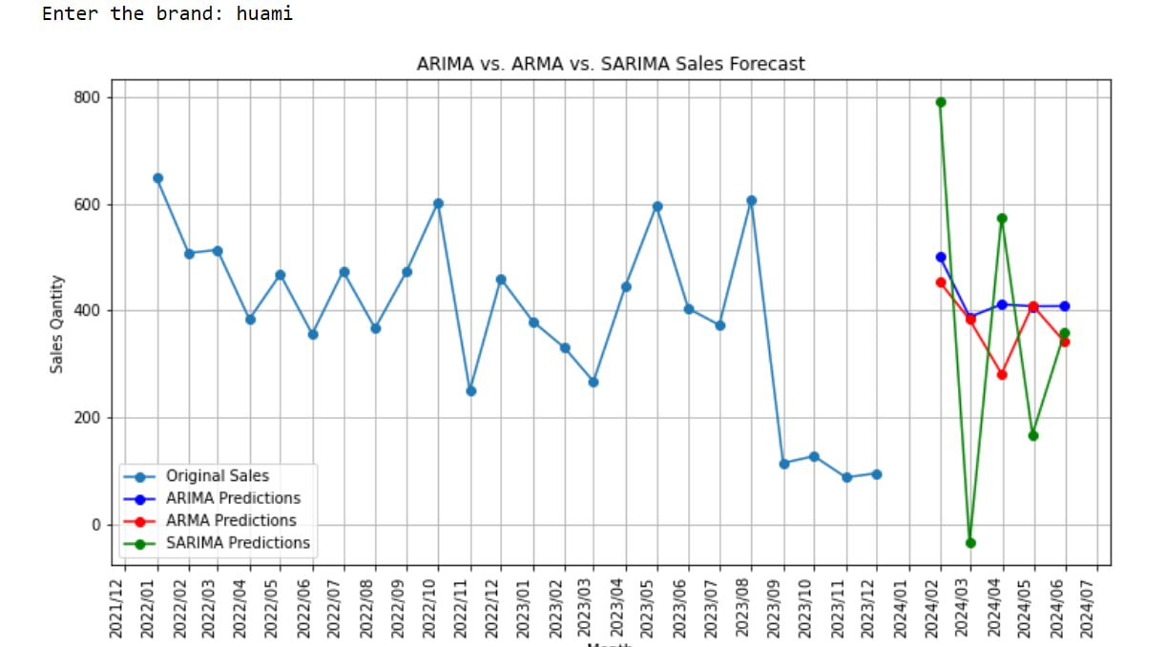

Slide 18
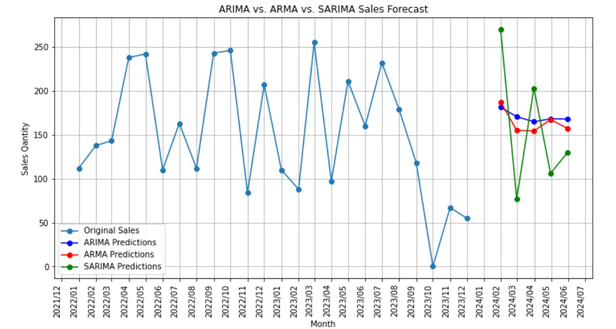

Slide 19
References
https://ieeexplore.ieee.org/document/10112431
https://www.phdata.io/blog/demand-forecasting-snowpark/
https://www.kaggle.com/code/prashant111/%20arima-model-for-time-series-forecasting.
https://ieeexplore.ieee.org/document/9363736

Slide 20
THANK YOU

